Slide 1


September 2023 Updates
Explore new ways to improve the sales process – with vablet.
Current Release: vablet 12.506/360 5.0.6
vablet/vablet 360 works on all platforms: Windows, Apple Mac, Mobile devices (phones and tablets): Android/Apple/Windows and via the web.

Slide 2


Update Overview
App Updates
Administrative Updates
iOS and iPadOS 17 compatible
Language File Settings
vablet works great with the latest iOS update, see which devices are supported
Select the Language and Country
Capture Enhancements
vablet Captures now support multiple or single (type form-like) responses and branding options.
Book a Meeting from a Meeting
Help reps schedule follow-up meetings
Fillable PDF Forms on vablet Web
Use PDF forms on all versions of vablet
Search by Language and Country
Find files using our new options
LEARN MORE
Windows Full Screen Mode
Available in vablet360 for Windows 10/11
Notes:
1.7.2013
‹#›

Slide 3
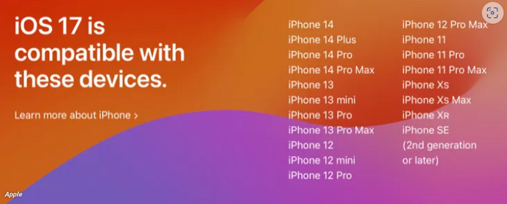
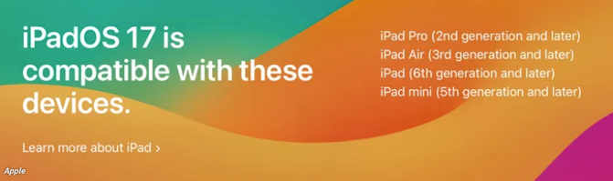
iOS and iPadOS 17 compatible
We highly recommend updating your device to the current version of iOS or iPadOS 17. vablet and vablet360 work great with 16/17.
Notes:
1.7.2013
‹#›

Slide 4
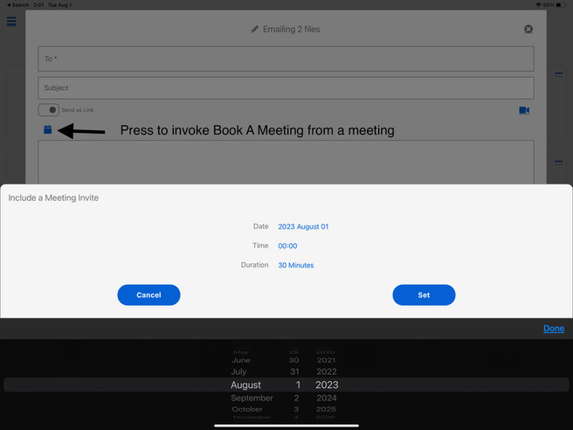
Book a Meeting from a Meeting
Schedule a follow-up meeting, from your device, before a current meeting ends.
Instructions
  Tag a file or files
  Open the options menu and select Email
  Tap on the Meeting icon
  Select a Date, Time, and Duration, and tap “SET”
  Add desired recipients and an invitation will be sent immediately, via email, along with the selected file(s) or template.
App Update

Slide 5
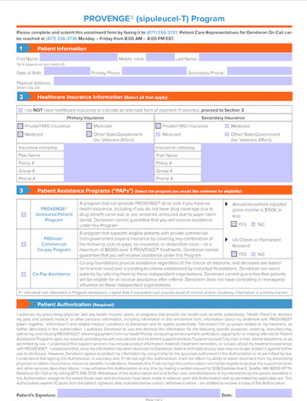
Fillable PDF Forms (on vablet Web)
Fillable PDF Forms are available across all vablet versions
Use Cases
  vablet supports two types of data capture forms: HTML and PDF.
  Both are uploaded via Capture and can be viewed on vablet iOS/Windows/Android/Web.
  Capture forms can be emailed from reps and completed by recipients when opened via the link provided.
  Both types can be configured (under Settings) to automatically forward completed copies to anyone in the organization, to push data into Salesforce, and with a tool like Zappier, to push data into over 700 other platforms.
App (Web) Update

Slide 6
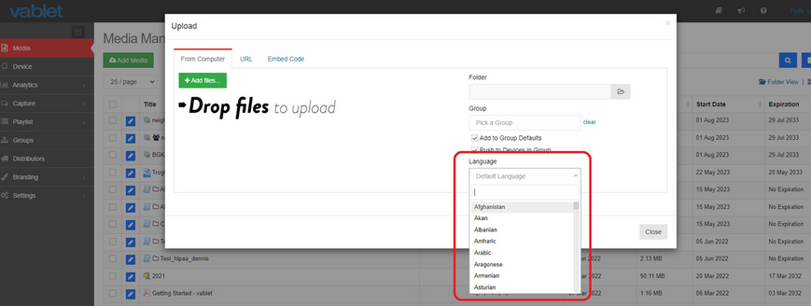
Language File Settings
Select a language when uploading to streamline file retrieval.
Instructions
  When uploading a file or files, tap on the Language dropdown. (The list can be edited under media attributes), but if selected when uploading, it’s easier and it will not have to be fixed later.
  Country settings are very helpful for reporting. This data is also used programmatically to empower custom launches.
Admin Update

Slide 7
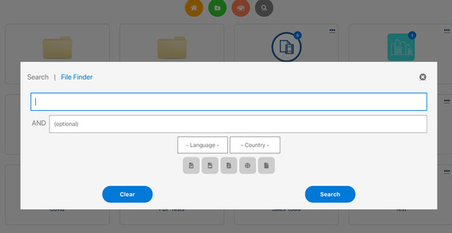
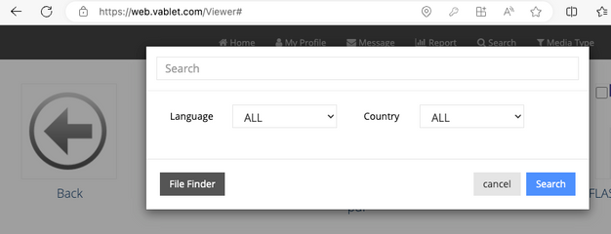
Search (by Language) Option
Effortlessly find specific language files with this new filter.
vablet Apps
Instructions:
  Press Search icon
  Enter title/part/mat no/tag
  Language
  Press the Search button
Tip:
If you do not know what file you are looking for, press FILE FINDER.
All of the files on the device, sortable by Title, Folder or Date Added, will be displayed.
vablet Web
App Update

Slide 8
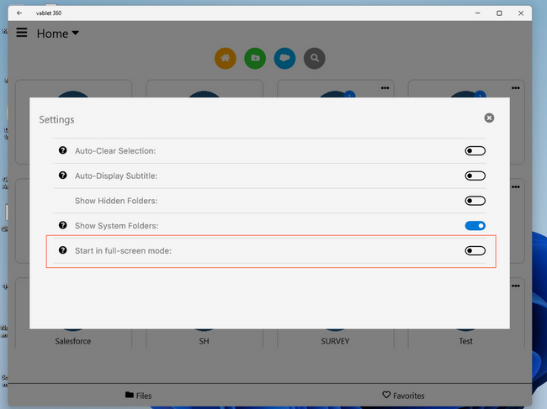
Windows Full Screen Mode
Experience Full Screen Mode with vablet360 on Windows
Instructions
  Go to Settings options
  Toggle switch to full-screen mode
App Update

Slide 9

Capture Enhancements
Create branded looking Forms optimizated for mobile use / sharing
Use Cases
  Collecting data is part of most sales processes. It can be meeting notes, gathering clients' requirements, or taking an order
  Forms are great for quizzing - you can link any file to a quiz upon close
  vablet supports Fillable PDF Forms, custom HTML Form/Apps, and Native Captures (A native capture is a form/data capture created via the vablet management console)
  All capture data can be accessed via a PDF, CSV, Email Body or via API or pushed to any object in Salesforce
Instructions
    Navigate to Capture, Capture Manager
    Add Capture
    Provide a Title and Group (Optional)
    Press ADD
Admin Update

Slide 10
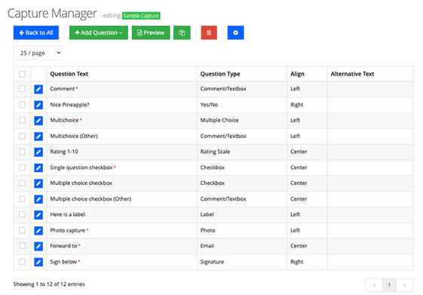
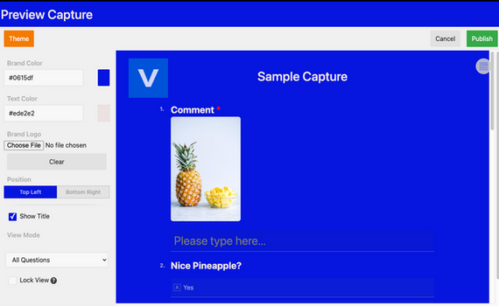
Branding and Previewing
Create branded looking Forms optimizated for mobile use
Instructions
    Add Question, Follow Prompts, repeat
    Press Preview
    Add Color, logo and select a layout (toggle)
    Publish - to Convert to HTML for distribution (A draft copy will be saved)
Layout Selector
Admin Update

Slide 11
Thank you for reviewing the 2023 Update.
In our next newsletter, we will showcase:
    vablet AI functionality
    new programming options
    new reports
If you have any questions, if you would like a personal demo of new or current features, or if you would like to improve how your vablet looks, please contact us at support@vablet.com or 800-615-4296.

